Slide 1
Operating system Lecture five part2
Dr jamal altuwaijari

Slide 2
5.6 Scheduling levels
A process migrates between the various scheduling queues through out its life time. The 0/S must select processes from these queues in some fashion
The selection process is carried out by the appropriate scheduler.
There are three levels (terms) of scheduling:

Slide 3
5.6.1 Long—term scheduler
The long—term scheduler or (job scheduler) selects processes from the job pool on the disk and loads them into memory for execution. The long—term scheduler execute much ten frequently there may be minutes between the creation of new processes in the system.
• The L.T.S control the degree of multi programming (The number of processes in memory).
If the degree of multi programming is stable then the average rate of processes creation must be equal to the-average departure rate of processes leaving the system
It is important that the L.T.S make a careftil selection. In general most processes can be described as either I/0 bound or CPU bound.
* An I/O bound process is one that spends more of its time doing I/O than it spends doing computations.
* A CPU—bound process is one that generates I/O requests infrequently, using more of its time doing computation than an 1/0—bound process. The L.T.S select a good process mix of I/O—bound and CPU—bound processes.

Slide 4
5.6.2 The short—tern scheduler (or CPU Scheduler)
It is selects from among the processes that are ready to execute and allocates the CPU to one of them. The S.T.S must select a new process for the CPU quite frequently. Often the S.T.S must be very fast.
If it takes 10 milliseconds to decide to executes a process for 100 milliseconds then 10/(100+10) — 9% of the CPU used (wasted) for scheduling the work. If all processes are I/O bound the ready queue will almost be empty and the S.T.S will have little to do. If all processes are CPU—bound the waiting queue will almost be empty.
The system with the best performance will have a combination of CPU—bound and I/O—bound processes.

Slide 5
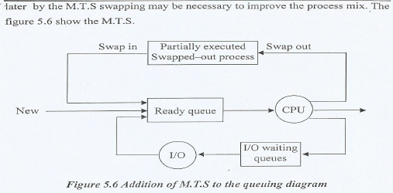
5.6.3 The medium term scheduler
Some 0/S such as time—sharing systems may introduce an additional intermediate level of scheduling. The key behind the M.T.S is that sometimes it can be advantageous to remove processes from memory and thus to reduce the degree of multi programming. The process can be swapped out and swapped in

Slide 6
5,7 Context switch
- Switching the CPU to another process requires saving the state of the old process and loading the saved state for the new process. The task is known as a context switch.
- Context—switch time is pure overhead because the system does no useful work while switching.
- The more complex the 0/S the more work must be done during a context switch.

Slide 7
5.8 Operations on Processes
- O/S that mange processes must be able to perform certain operation on and with processes. These include: create, destroy, suspend, resume, change a process priority, block a process, wake up a process dispatch a process, enable a process to communicate with another process.
- Creating a process involves many operations including: name a process, insert it in the ready queue, determine the process initial priority, create the PCB, allocate the process's initial resources.
A process may create a new process. If it does the creating process is called the parent process and the created process is called the child process. Such creation yields a hierarchical process structure as in the figure 5.7.

Slide 8
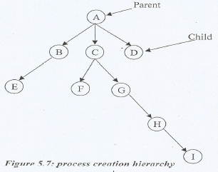
5.8 Operations on Processes

Slide 9
5.8 Operations on Processes
When a process create a new process two possibilities exist in terms of execution:
a. The parent continues to execute concurrently with its children.
b. The parent waits until some or all of its children have terminated.
A process terminates when it finishes executing its last statement and asks the 0/S to delete it by using the exist system call.
A parent may terminate the execution of one of its children for a variety at reasons such as:
• The child has exceeded its usage of some of the resources it has been allocated.
• The task assigned to the child is no longer required.
• The parent is existing and the 0/S does not allow a child to continue if its parent terminated.

Slide 10
5.9 Cooperating Processes
The concurrent processes executing in the 0/S may be either independent processes of cooperating processes.
A process is independent if it cannot affect or be affected by the tither processes executing in the system. Any process that does not share or any data (temporary or persistent) with any other process is independent.
A process is cooperating if it can affect or be affected by the other processes executing in the system or any process that share data with other processes is a cooperating process.
There are several reasons for providing an environment that allows process cooperation:
1. Information sharing.
2. Computation speedup.
3. Modularity: Dividing the system functions into scparat processes.
4. Convenience, Many tasks to work on at one time, a user may be editing. printing and compiling in parallel.

Slide 11
5.9 Cooperating Processes
To illustrate the concept of cooperating processes let us consider the producer—consumer problem as an example of cooperating processes.
A produce process produces information that is consumed by a consumer process.
For example, a print program produces characters that are consumed by the printer driver.
To allow producer and consumer to run concurrently we must have a buffer of item that can be filled by the producer and emptied by the consumer.
A producer can produce one item while the consumer is consuming another item. The producer and consumer must be synchronized. The consumer must wait until an item is produced (the buffer is empty) and the producer must wait if the buffer is full.
In the bounded—buffer and be one solution for the producer and consumer processes share the following variables:
var n;
type item = ……;
var buffer: array [0…n-I] of item;
in, out: 0..n-1
with in. out initialized to the value 0. The shared buffer is implemented as a circular array with two logical pointer: in and out.
in points to the next free position in the buffer; out points to the first full position in the buffer.
The buffer is empty when in—out; the Suffer is full when in+1 mod n=out.

Slide 12
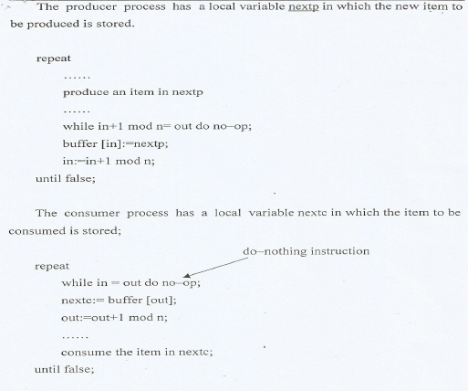
5.9 Cooperating Processes

Slide 13
5.10Thread structure
- A thread sometimes called light weight process (LWP) is a basic unit of CPU utilization and consists of a program counter, a register set, and a stack space.
It shares with peer threads its code section, data section and 0/S resources such as open files and signals collectively known as a task.
A traditional or heavy weight process is equal to a tasks with one thread.
Threads can be in one of several states ready, blocked, running, or terminated. Threads can create child threads if one thread is blocked another thread can run.
Unlike processes threads are not independent of one another, because all threads can access in the task.

Slide 14
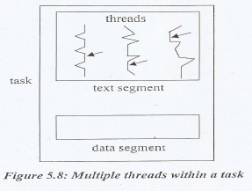
5.10Thread structure

